Slide 1
Single Electron Capture from Atomic and Molecular Collisions Using Advanced Theoretical Methods
by
David Lyons
(Under the Direction of Phillip C. Stancil)

Slide 2
Abstract
Two computational methods are used to calculate cross sections of a number of ion/atom/molecule collision systems where a single electron is stripped from one particle and captured by the other. In these collisions systems, one particle is a charged ion (projectile); the other, a neutral atom or molecule (target).
The two computational methods are:
Multi-Channel Landau-Zener (MCLZ)
Molecular Orbital Close-Coupling (MOCC)

Slide 3
Introduction
Given continual improvements in technologies used to observe objects and regions in space, it has been determined that charge-exchange (CE) is one of the dominant processes for X-ray emissions in certain circumstances, such as comets, atmospheres of certain exoplanets, the Heliosphere, supernova remnants, and situations where hot plasmas meet cold gas.
There is a shortage of reliable CE cross-sectional data to allow for quantitative spectroscopic models. The studies here partially address this situation, by calculating cross sections as a function of kinetic energy from single electron capture (SEC) CE interaction for certain collision systems.

Slide 4
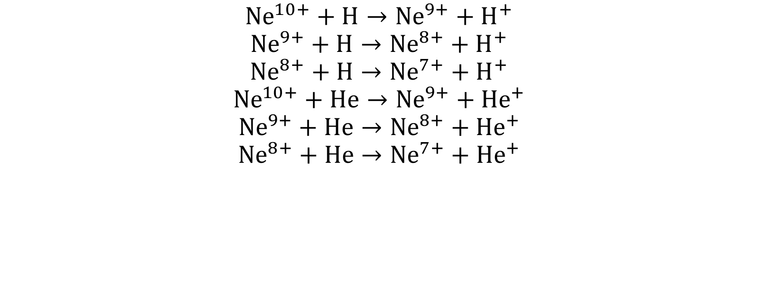
$${Ne}^{10+}+H→{Ne}^{9+}+H^{+}$$
$${Ne}^{9+}+H→{Ne}^{8+}+H^{+}$$
$${Ne}^{8+}+H→{Ne}^{7+}+H^{+}$$
$${Ne}^{10+}+He→{Ne}^{9+}+{He}^{+}$$
$${Ne}^{9+}+He→{Ne}^{8+}+{He}^{+}$$
$${Ne}^{8+}+He→{Ne}^{7+}+{He}^{+}$$

Slide 5
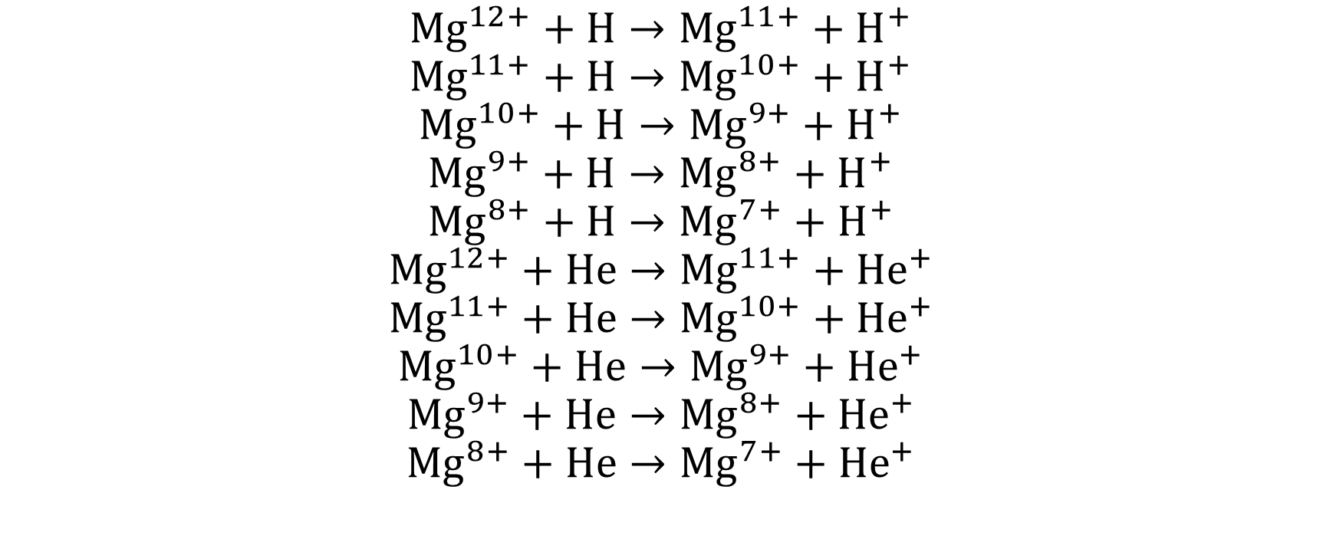
$${Mg}^{12+}+H→{Mg}^{11+}+H^{+}$$
$${Mg}^{11+}+H→{Mg}^{10+}+H^{+}$$
$${Mg}^{10+}+H→{Mg}^{9+}+H^{+}$$
$${Mg}^{9+}+H→{Mg}^{8+}+H^{+}$$
$${Mg}^{8+}+H→{Mg}^{7+}+H^{+}$$
$${Mg}^{12+}+He→{Mg}^{11+}+{He}^{+}$$
$${Mg}^{11+}+He→{Mg}^{10+}+{He}^{+}$$
$${Mg}^{10+}+He→{Mg}^{9+}+{He}^{+}$$
$${Mg}^{9+}+He→{Mg}^{8+}+{He}^{+}$$
$${Mg}^{8+}+He→{Mg}^{7+}+{He}^{+}$$

Slide 6
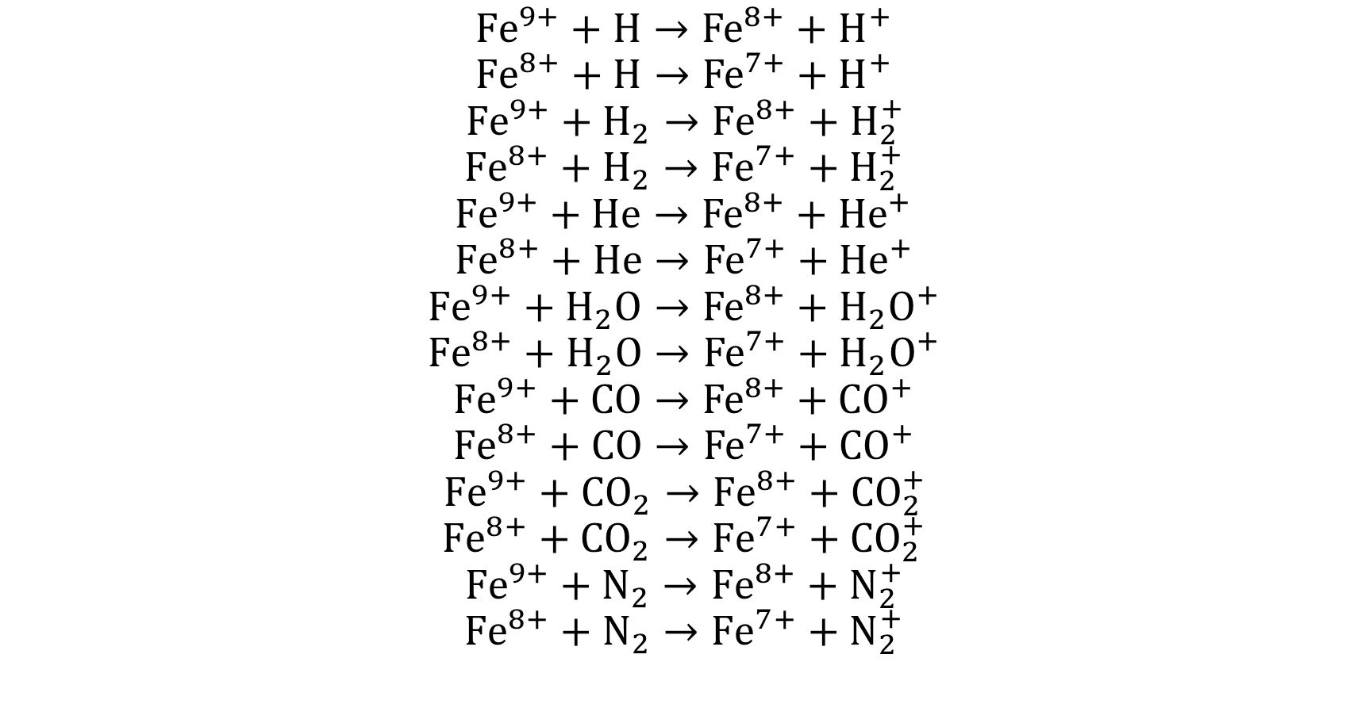
$${Fe}^{9+}+H→{Fe}^{8+}+H^{+}$$
$${Fe}^{8+}+H→{Fe}^{7+}+H^{+}$$
$${Fe}^{9+}+H_{2}→{Fe}^{8+}+H_{2}^{+}$$
$${Fe}^{8+}+H_{2}→{Fe}^{7+}+H_{2}^{+}$$
$${Fe}^{9+}+He→{Fe}^{8+}+{He}^{+}$$
$${Fe}^{8+}+He→{Fe}^{7+}+{He}^{+}$$
$${Fe}^{9+}+H_{2}O→{Fe}^{8+}+H_{2}O^{+}$$
$${Fe}^{8+}+H_{2}O→{Fe}^{7+}+H_{2}O^{+}$$
$${Fe}^{9+}+CO→{Fe}^{8+}+{CO}^{+}$$
$${Fe}^{8+}+CO→{Fe}^{7+}+{CO}^{+}$$
$${Fe}^{9+}+{CO}_{2}→{Fe}^{8+}+{CO}_{2}^{+}$$
$${Fe}^{8+}+{CO}_{2}→{Fe}^{7+}+{CO}_{2}^{+}$$
$${Fe}^{9+}+N_{2}→{Fe}^{8+}+N_{2}^{+}$$
$${Fe}^{8+}+N_{2}→{Fe}^{7+}+N_{2}^{+}$$

Slide 7
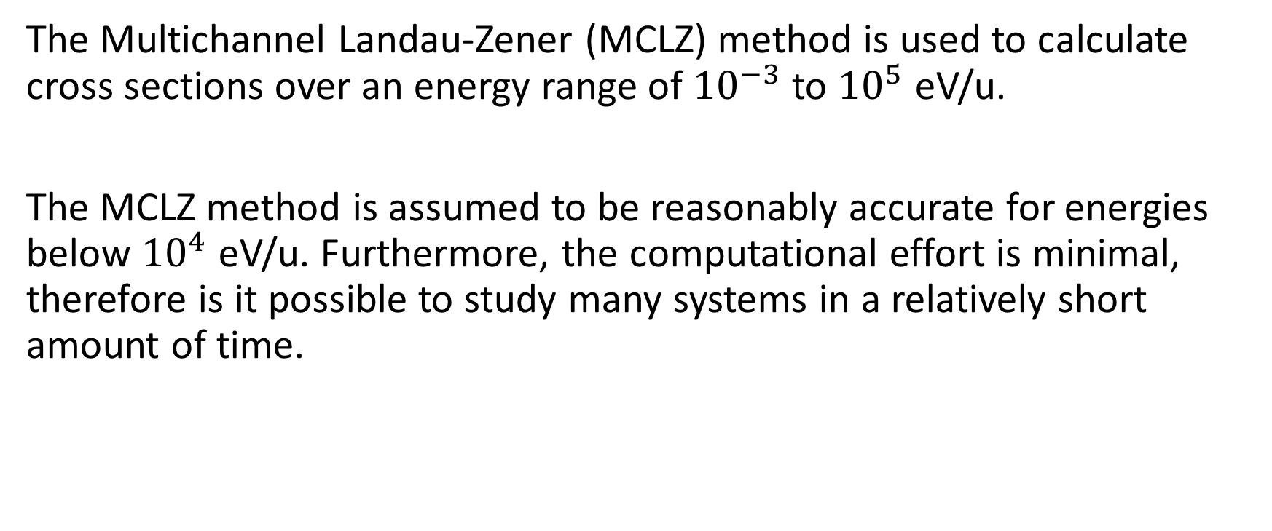
The Multichannel Landau-Zener (MCLZ) method is used to calculate cross sections over an energy range of ${10}^{−3}$ to ${10}^{5}$ eV/u.
The MCLZ method is assumed to be reasonably accurate for energies below ${10}^{4}$ eV/u. Furthermore, the computational effort is minimal, therefore is it possible to study many systems in a relatively short amount of time.

Slide 8
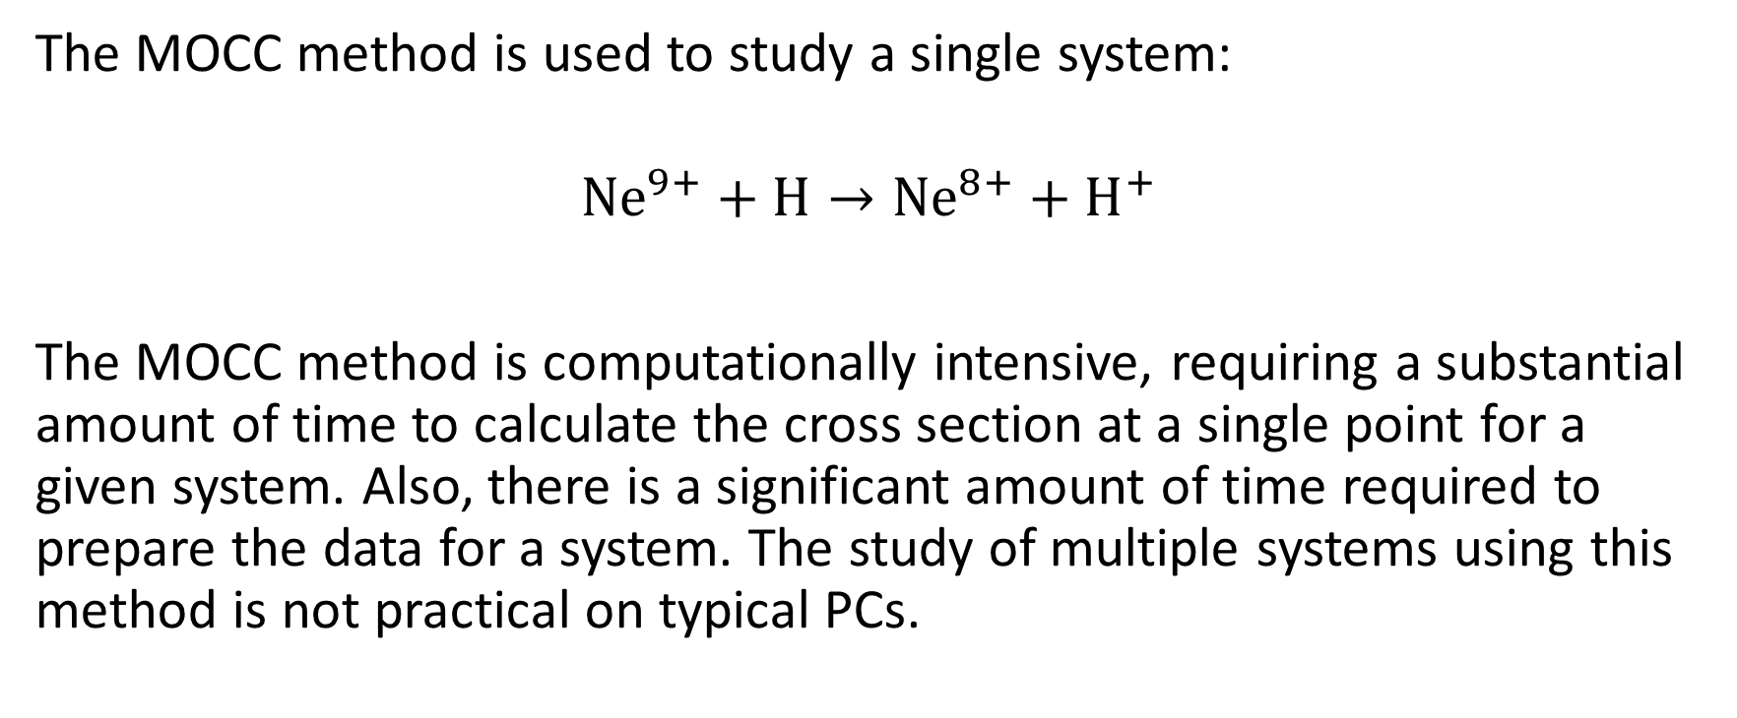
The MOCC method is used to study a single system:
$${Ne}^{9+}+H→{Ne}^{8+}+H^{+}$$
The MOCC method is computationally intensive, requiring a substantial amount of time to calculate the cross section at a single point for a given system. Also, there is a significant amount of time required to prepare the data for a system. The study of multiple systems using this method is not practical on typical PCs.

Slide 9
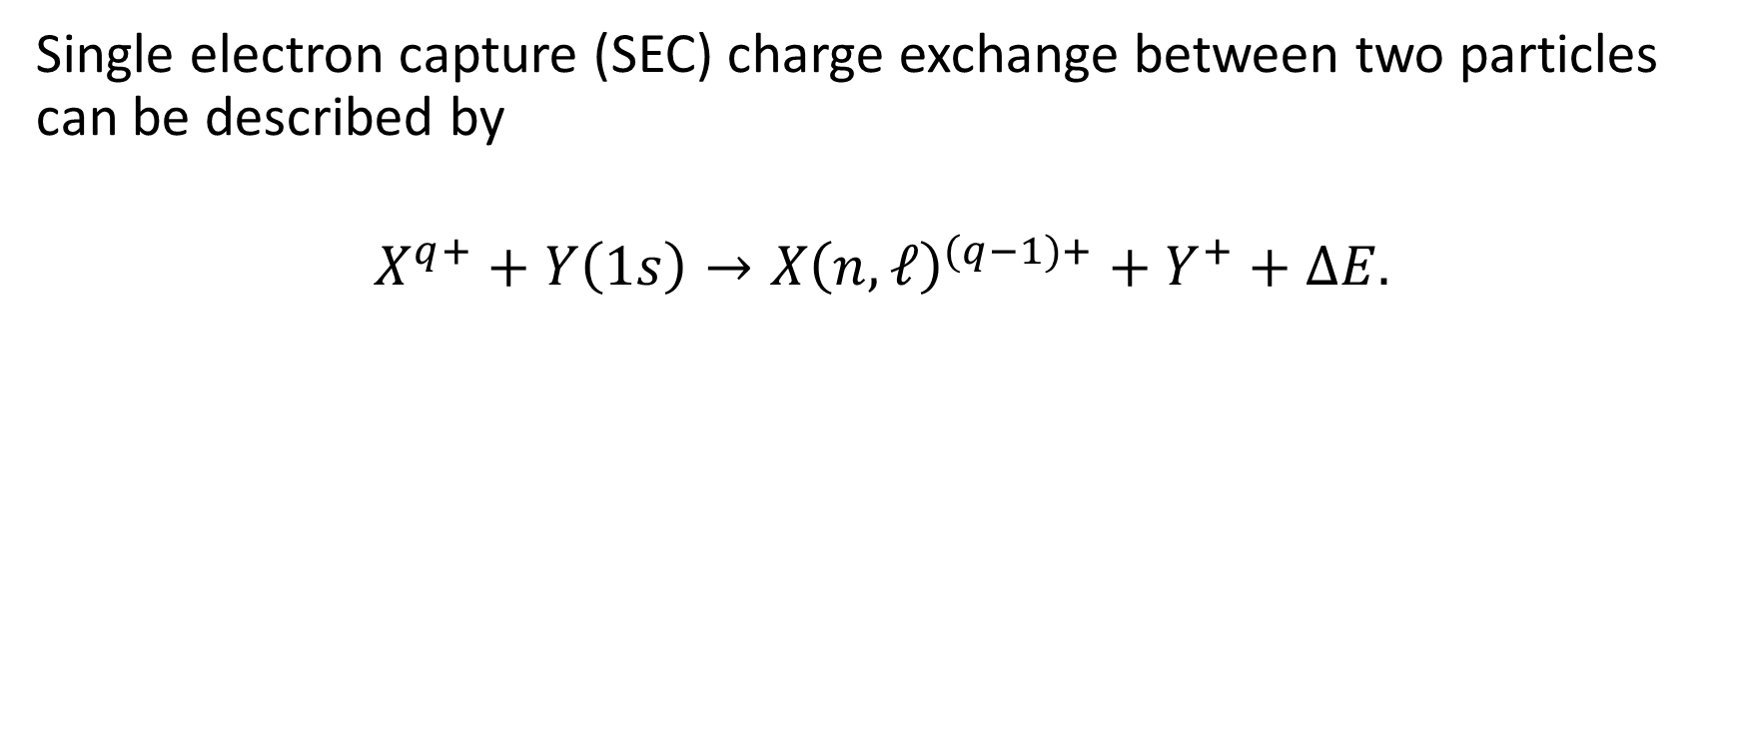
Theory
Single electron capture (SEC) charge exchange between two particles can be described by
$$X^{q+}+Y\left(1s\right)→X{\left(n,ℓ\right)}^{(q−1)+}+Y^{+}+ΔE.$$

Slide 10
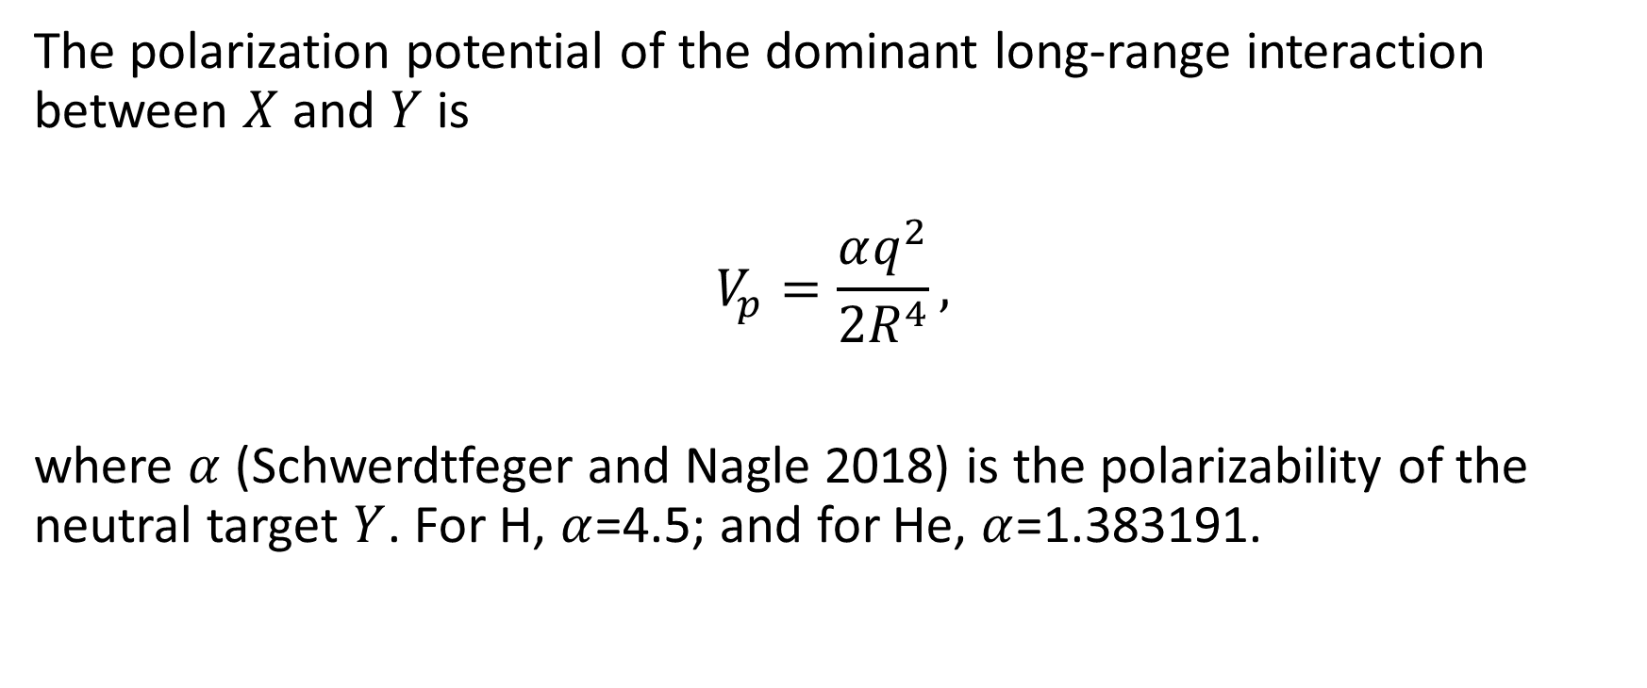
The polarization potential of the dominant long-range interaction between $X$ and $Y$ is
$$V_{p}=\frac{αq^{2}}{2R^{4}},$$
where $α$ (Schwerdtfeger and Nagle 2018) is the polarizability of the neutral target $Y$. For H, $α$=4.5; and for He, $α$=1.383191.

Slide 11
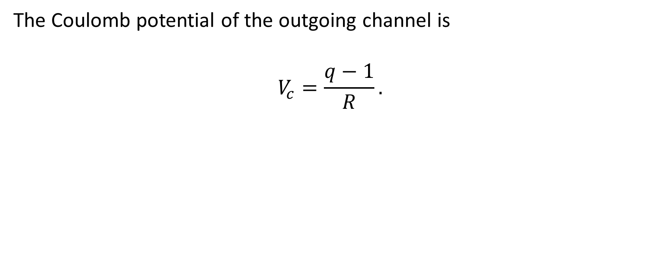
The Coulomb potential of the outgoing channel is
$$V_{c}=\frac{q−1}{R}.$$

Slide 13
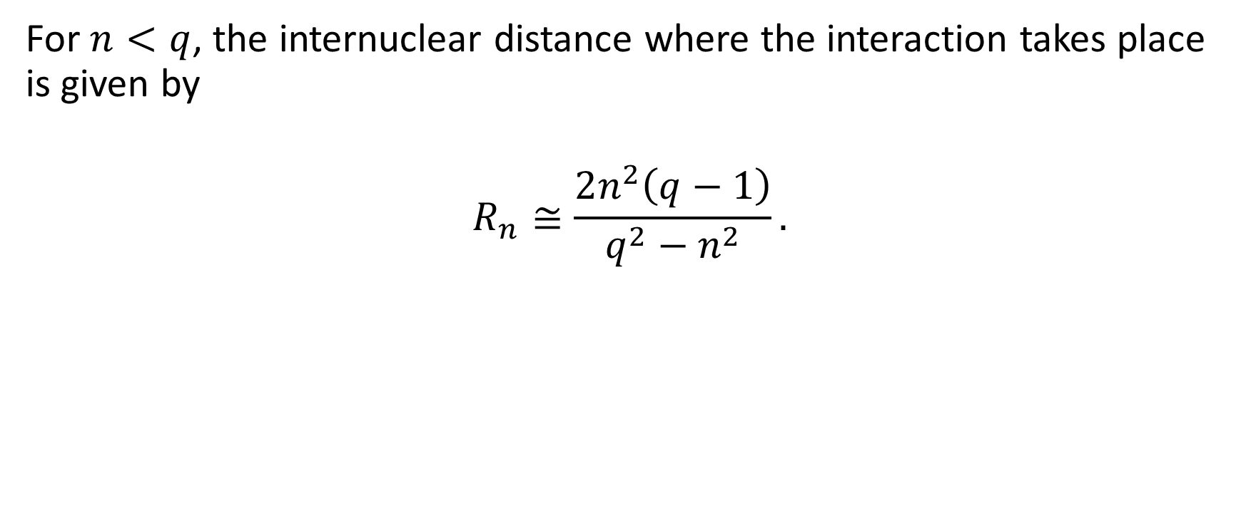
For $n<q$, the internuclear distance where the interaction takes place is given by
$$R_{n}≅\frac{2n^{2}\left(q−1\right)}{q^{2}−n^{2}}.$$

Slide 14
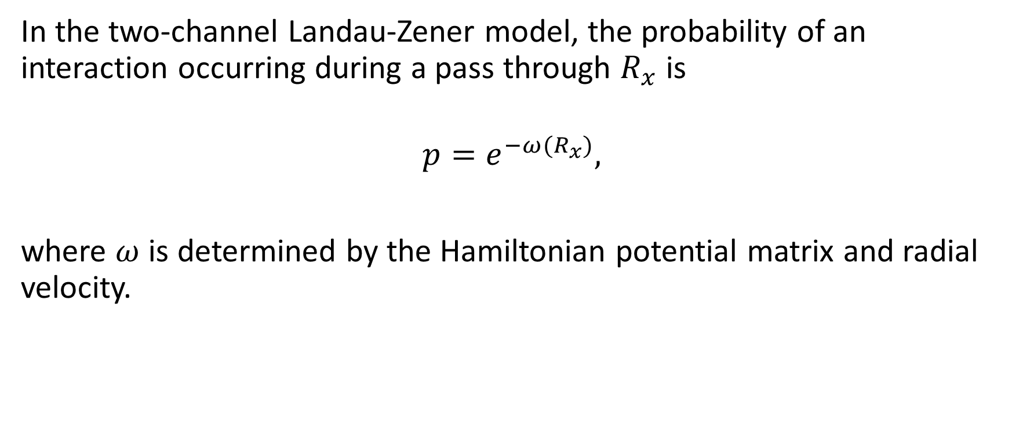
In the two-channel Landau-Zener model, the probability of an interaction occurring during a pass through $R_{x}$ is
$$p=e^{−ω(R_{x})},$$
where $ω$ is determined by the Hamiltonian potential matrix and radial velocity.

Slide 15
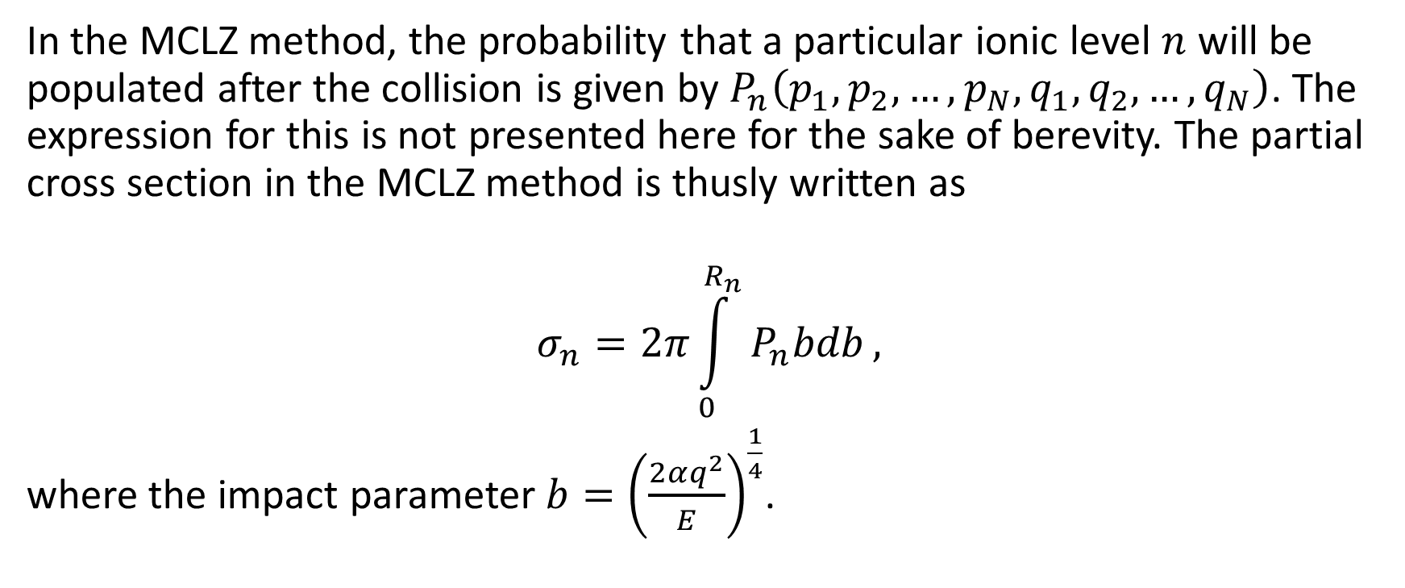
In the MCLZ method, the probability that a particular ionic level $n$ will be populated after the collision is given by $P_{n}\left(p_{1},p_{2},…,p_{N},q_{1},q_{2},…,q_{N}\right)$. The expression for this is not presented here for the sake of berevity. The partial cross section in the MCLZ method is thusly written as
$$σ_{n}=2π\int_{0}^{R_{n}}{P_{n}bdb},$$
where the impact parameter $b={\left(\frac{2αq^{2}}{E}\right)}^{\frac{1}{4}}$.

Slide 16
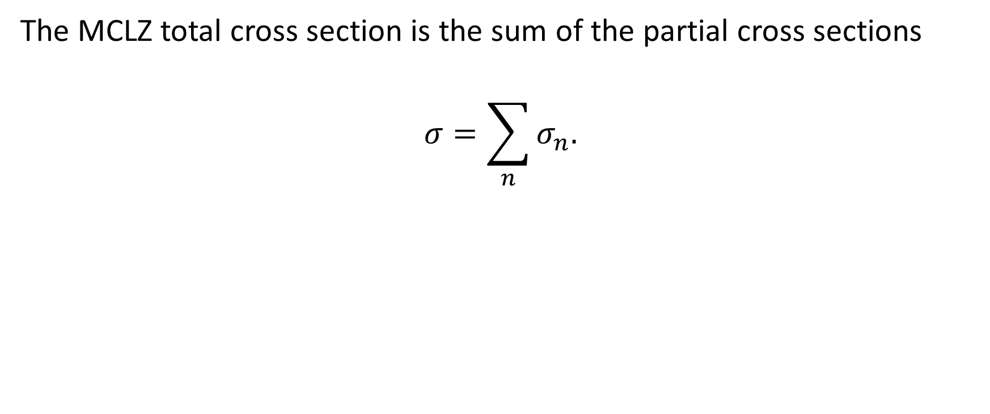
The MCLZ total cross section is the sum of the partial cross sections
$$σ=\sum_{n}{σ_{n}.}$$

Slide 17
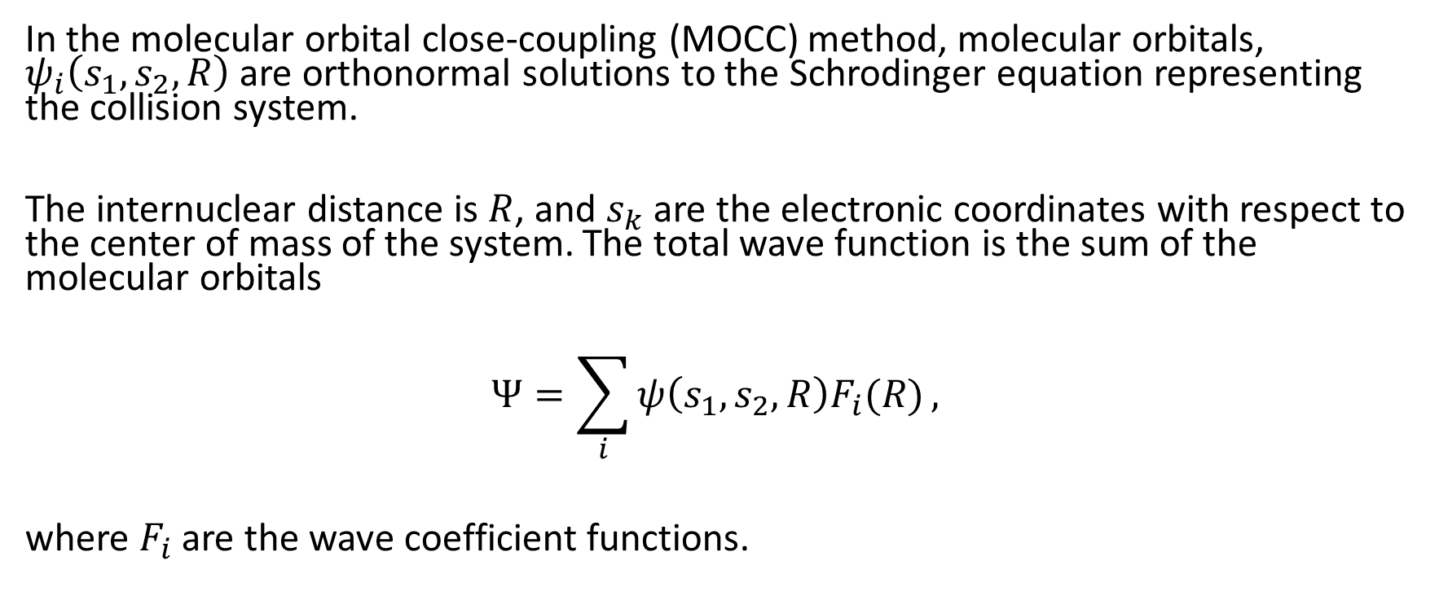
In the molecular orbital close-coupling (MOCC) method, molecular orbitals, $ψ_{i}\left(s_{1},s_{2},R\right)$ are orthonormal solutions to the Schrodinger equation representing the collision system.
The internuclear distance is $R$, and $s_{k}$ are the electronic coordinates with respect to the center of mass of the system. The total wave function is the sum of the molecular orbitals
$$Ψ=\sum_{i}{ψ\left(s_{1},s_{2},R\right)F_{i}(R)},$$
where $F_{i}$ are the wave coefficient functions.

Slide 18
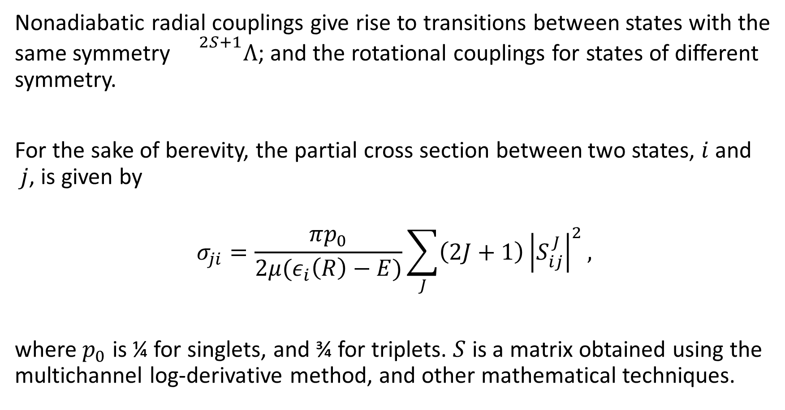
Nonadiabatic radial couplings give rise to transitions between states with the same symmetry ${}^{2S+1}Λ$; and the rotational couplings for states of different symmetry.
For the sake of berevity, the partial cross section between two states, $i$ and $j$, is given by
$$σ_{ji}=\frac{πp_{0}}{2μ(ε_{i}\left(R\right)−E)}\sum_{J}{\left(2J+1\right){\left|S_{ij}^{J}\right|}^{2}},$$
where $p_{0}$ is ¼ for singlets, and ¾ for triplets. $S$ is a matrix obtained using the multichannel log-derivative method, and other mathematical techniques.

Slide 19
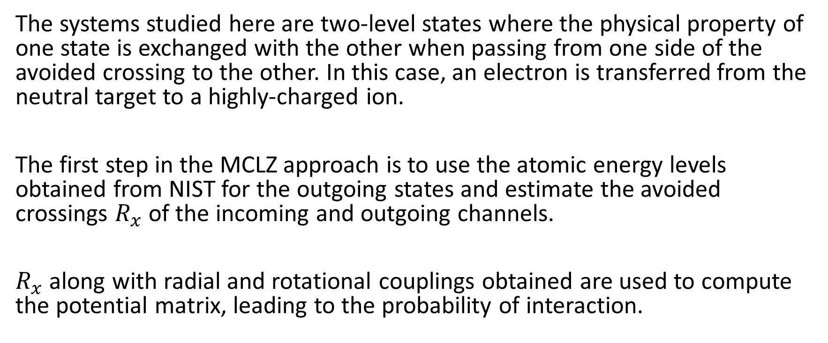
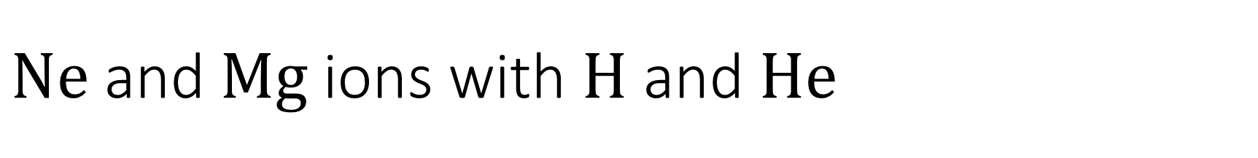
$Ne$ and $Mg$ ions with $H$ and $He$
The systems studied here are two-level states where the physical property of one state is exchanged with the other when passing from one side of the avoided crossing to the other. In this case, an electron is transferred from the neutral target to a highly-charged ion.
The first step in the MCLZ approach is to use the atomic energy levels obtained from NIST for the outgoing states and estimate the avoided crossings $R_{x}$ of the incoming and outgoing channels.
$R_{x}$ along with radial and rotational couplings obtained are used to compute the potential matrix, leading to the probability of interaction.

Slide 20
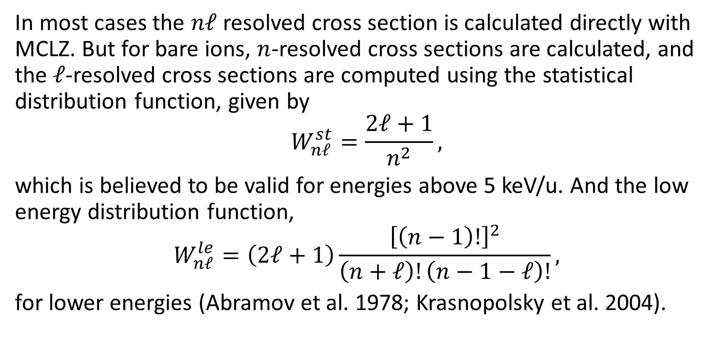
In most cases the $nℓ$ resolved cross section is calculated directly with MCLZ. But for bare ions, $n$-resolved cross sections are calculated, and the $ℓ$-resolved cross sections are computed using the statistical distribution function, given by
$$W_{nℓ}^{st}=\frac{2ℓ+1}{n^{2}},$$
which is believed to be valid for energies above 5 keV/u. And the low energy distribution function,
$$W_{nℓ}^{le}=\left(2ℓ+1\right)\frac{{\left[\left(n−1\right)!\right]}^{2}}{\left(n+ℓ\right)!\left(n−1−ℓ\right)!},$$
for lower energies (Abramov et al. 1978; Krasnopolsky et al. 2004).

Slide 21
MCLZ total cross sections

Slide 22
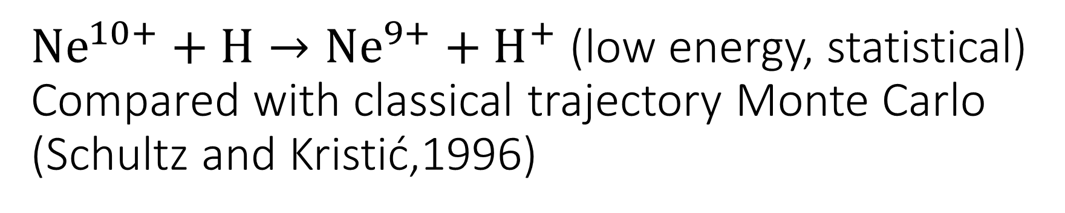
${Ne}^{10+}+H→{Ne}^{9+}+H^{+}$ (low energy, statistical) Compared with classical trajectory Monte Carlo (Schultz and Kristić,1996)

Slide 23
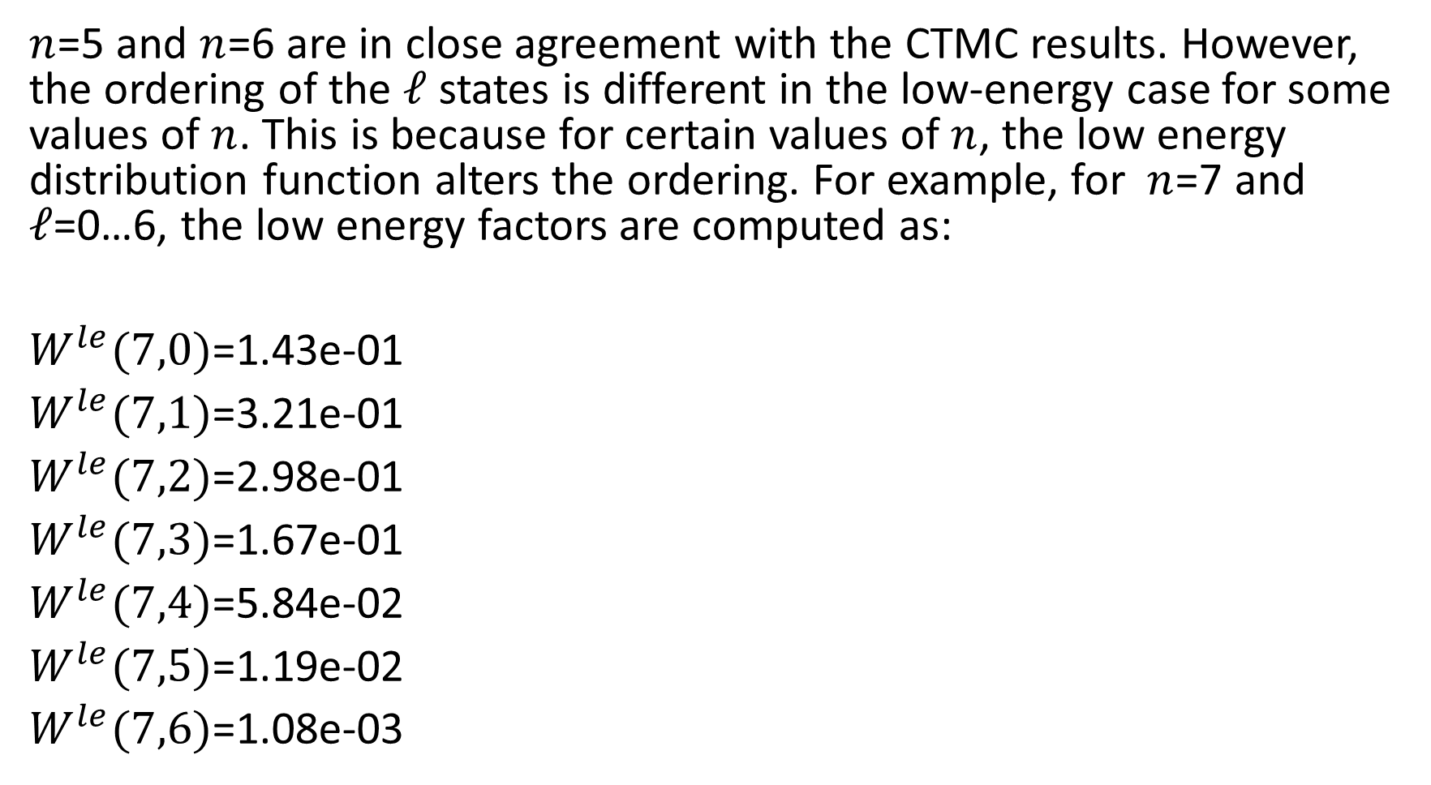
$n$=5 and $n$=6 are in close agreement with the CTMC results. However, the ordering of the $ℓ$ states is different in the low-energy case for some values of $n$. This is because for certain values of $n$, the low energy distribution function alters the ordering. For example, for $n$=7 and $ℓ$=0…6, the low energy factors are computed as:
$W^{le}(7,0)$=1.43e-01
$W^{le}(7,1)$=3.21e-01
$W^{le}(7,2)$=2.98e-01
$W^{le}(7,3)$=1.67e-01
$W^{le}(7,4)$=5.84e-02
$W^{le}(7,5)$=1.19e-02
$W^{le}(7,6)$=1.08e-03

Slide 24
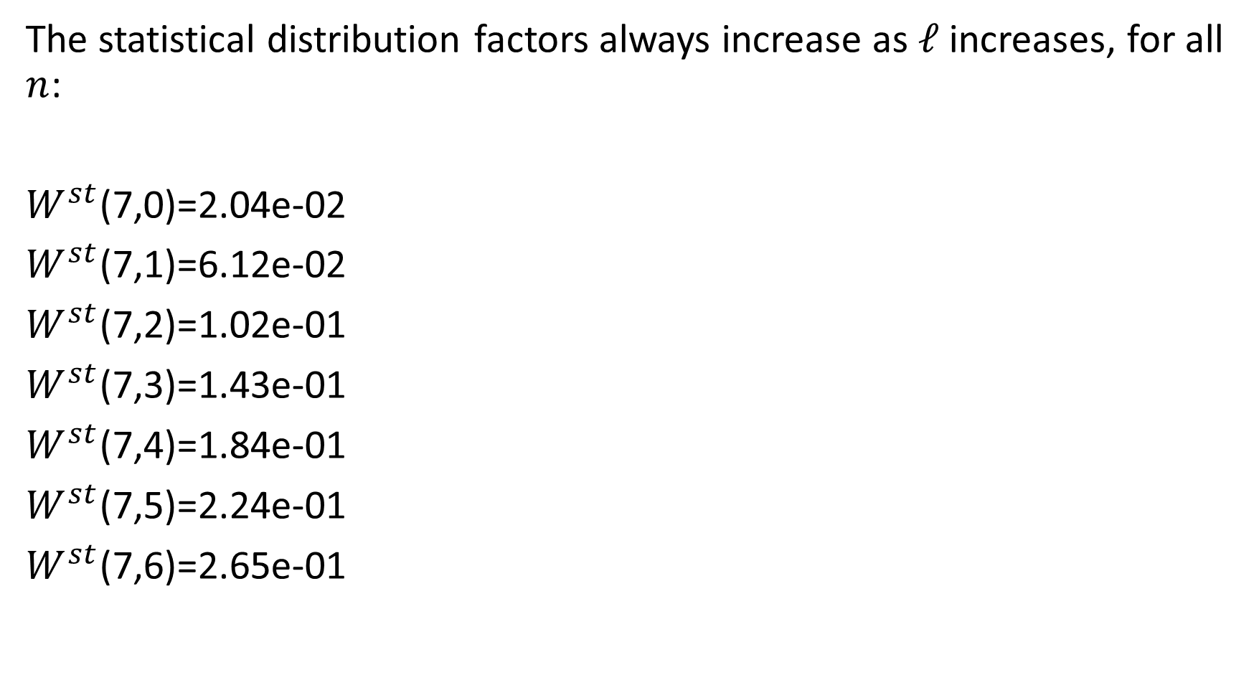
The statistical distribution factors always increase as $ℓ$ increases, for all $n$:
$W^{st}$(7,0)=2.04e-02
$W^{st}$(7,1)=6.12e-02
$W^{st}$(7,2)=1.02e-01
$W^{st}$(7,3)=1.43e-01
$W^{st}$(7,4)=1.84e-01
$W^{st}$(7,5)=2.24e-01
$W^{st}$(7,6)=2.65e-01

Slide 25
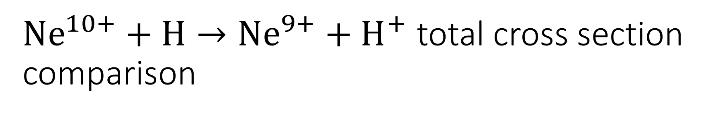
${Ne}^{10+}+H→{Ne}^{9+}+H^{+}$ total cross section comparison

Slide 26
Solid black line – this study
(a) CTMC (Olson and Salop 1977)
(b) CTMC microcanonical (Errea et al. 2004)
(c) OEDM (Errea et al. 2004)
(d) CTMC (Perez et al. 2001)
(e) CTMC hydrogenic (Errea et al. 2004)
(f) experimental (Bendahman et al. 1985)
(g) theory (Grozdanov 1980)
(h) CTMC (Maynard et al. 1992)
experimental (Meyer et al. 1985)
(j) CTMC (Schultz and Kristić 1996)

Slide 27
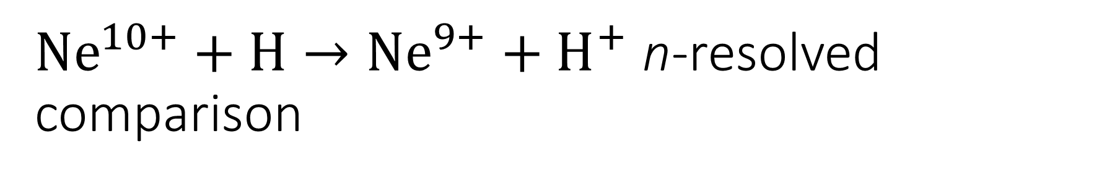
${Ne}^{10+}+H→{Ne}^{9+}+H^{+}$ n-resolved comparison

Slide 28
Bendahman et al. (1985)
(b) AOCC (Cumbee et al. 2016)
(c) CTMC (Perez et al. 2001)
(d) CTMC (Olson and Salop 1977)
(e) CTMC hydrogenic (Errea et al. 2004)
(f) current MCLZ
(g) CTMC micro-canonical (Errea et al. 2004)
(h) CTMC (Maynard et al. 1992)
(i) OEDM (Errea et al. 2004)
(j) CTMC (Schultz and Kristić 1996)

Slide 29
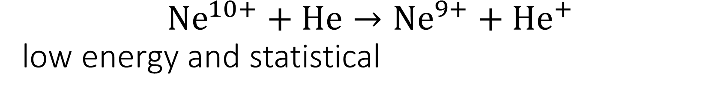
$${Ne}^{10+}+He→{Ne}^{9+}+{He}^{+}$$ low energy and statistical

Slide 30

$${Ne}^{10+}+He→{Ne}^{9+}+{He}^{+}$$ CTMC cross sections of Ali et al. (2010)

Slide 31
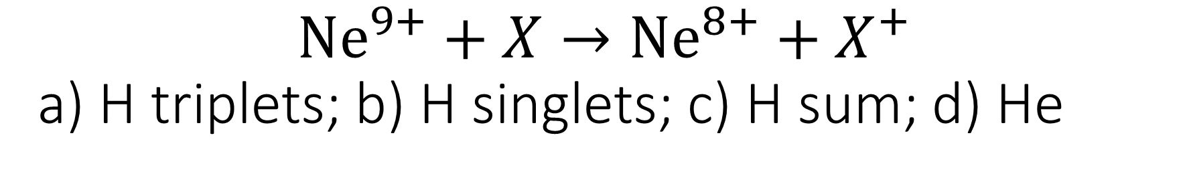
$${Ne}^{9+}+X→{Ne}^{8+}+X^{+}$$ a) H triplets; b) H singlets; c) H sum; d) He

Slide 32
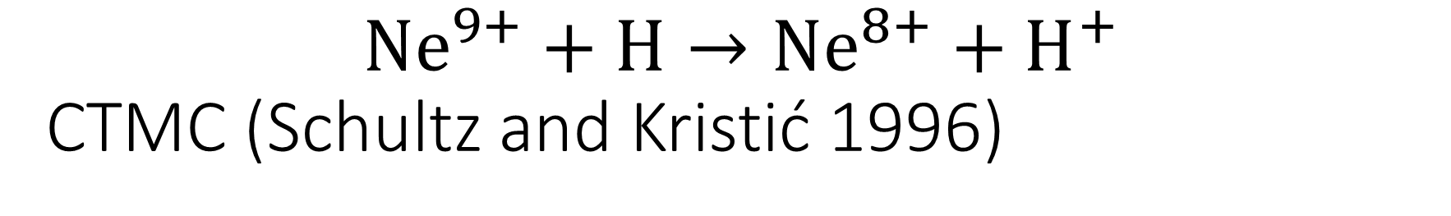
$${Ne}^{9+}+H→{Ne}^{8+}+H^{+}$$ CTMC (Schultz and Kristić 1996)

Slide 33
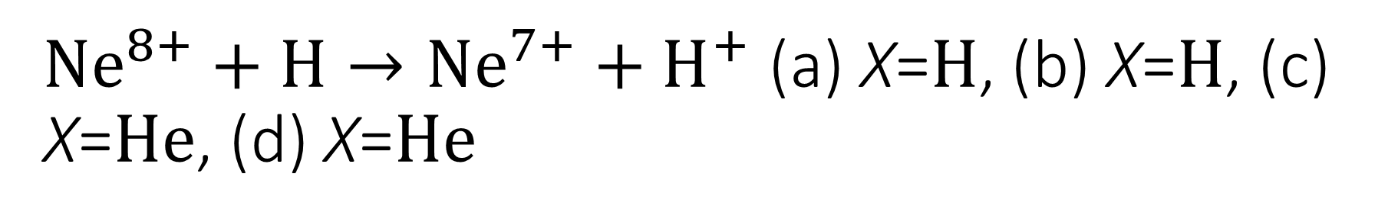
${Ne}^{8+}+H→{Ne}^{7+}+H^{+}$ (a) X=$H$, (b) X=$H$, (c) X=$He$, (d) X=$He$

Slide 34
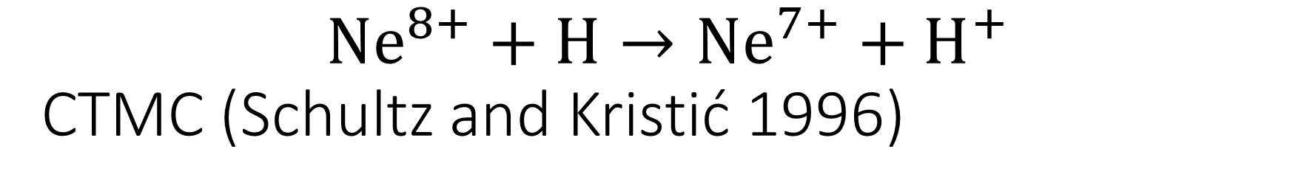
$${Ne}^{8+}+H→{Ne}^{7+}+H^{+}$$ CTMC (Schultz and Kristić 1996)

Slide 35

$${Mg}^{12+}+H→{Mg}^{11+}+H^{+}$$

Slide 36
$${Mg}^{12+}+H→{Mg}^{11+}+H^{+}$$

Slide 37

$${Mg}^{12+}+He→{Mg}^{11+}+{He}^{+}$$

Slide 38
$${Mg}^{12+}+He→{Mg}^{11+}+{He}^{+}$$

Slide 39
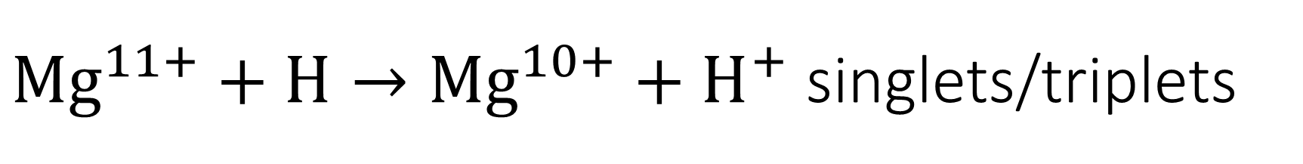
${Mg}^{11+}+H→{Mg}^{10+}+H^{+}$ singlets/triplets

Slide 40

$${Mg}^{11+}+H→{Mg}^{10+}+H^{+}$$

Slide 41

$${Mg}^{11+}+He→{Mg}^{10+}+{He}^{+}$$

Slide 42

$${Mg}^{10+}+X→{Mg}^{9+}+X^{+}$$

Slide 43
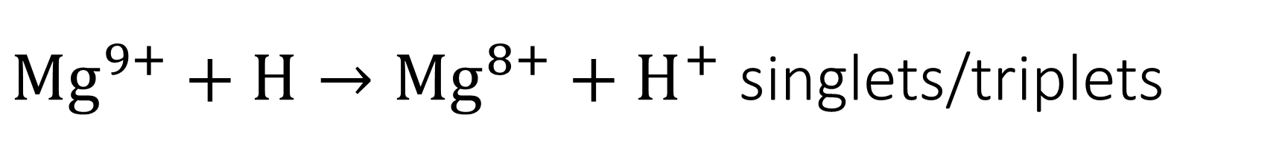
${Mg}^{9+}+H→{Mg}^{8+}+H^{+}$ singlets/triplets

Slide 44

$${Mg}^{9+}+He→{Mg}^{8+}+{He}^{+}$$

Slide 45

$${Mg}^{8+}+X→{Mg}^{7+}+X^{+}$$

Slide 46
Summary
Using the MCLZ method, cross sections were calculated for Ne and Mg ions colliding with H and He atoms, and capturing the atoms’ electron.
The cross sections were compared to other theoretical and experimental results where available.
It was determined that the results here were in reasonably close agreement with the compared data. And thus, the MCLZ method gives a good estimation of SEC cross sections.

Slide 47
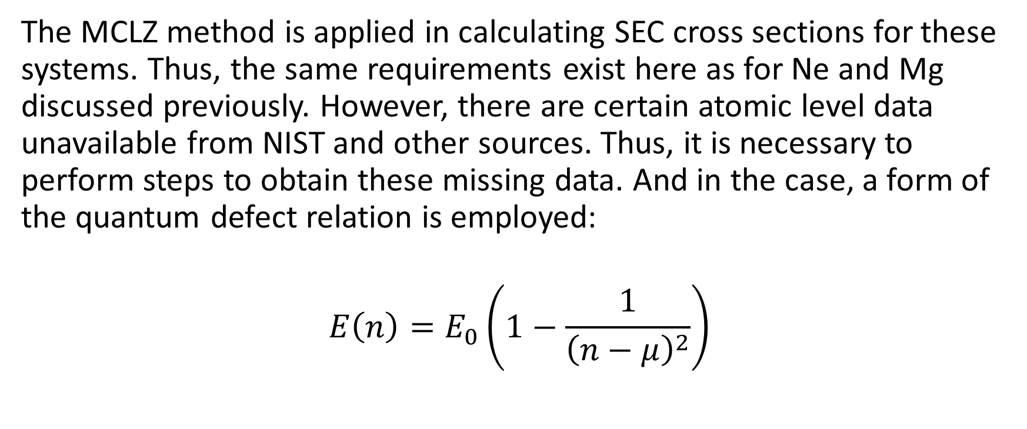
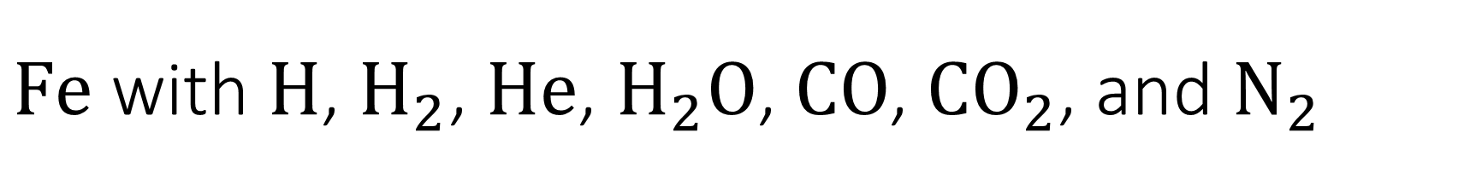
$Fe$ with $H$, $H_{2}$, $He$, $H_{2}O$, $CO$, ${CO}_{2}$, and $N_{2}$
The MCLZ method is applied in calculating SEC cross sections for these systems. Thus, the same requirements exist here as for Ne and Mg discussed previously. However, there are certain atomic level data unavailable from NIST and other sources. Thus, it is necessary to perform steps to obtain these missing data. And in the case, a form of the quantum defect relation is employed:
$$E\left(n\right)=E_{0}\left(1−\frac{1}{{\left(n−μ\right)}^{2}}\right)$$

Slide 48
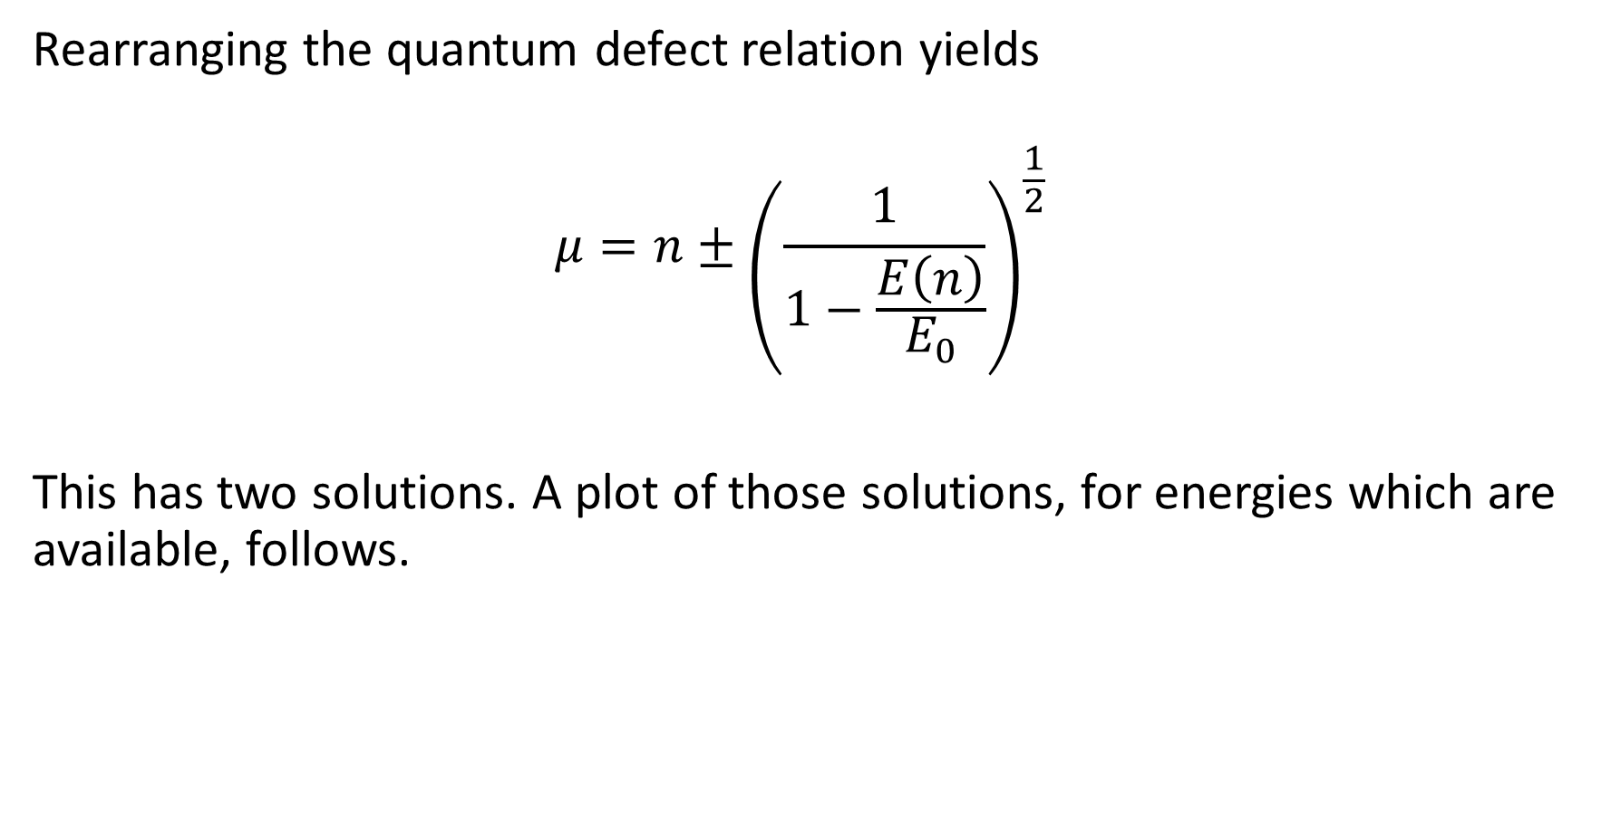
Rearranging the quantum defect relation yields
$$μ=n±{\left(\frac{1}{1−\frac{E\left(n\right)}{E_{0}}}\right)}^{\frac{1}{2}}$$
This has two solutions. A plot of those solutions, for energies which are available, follows.

Slide 50
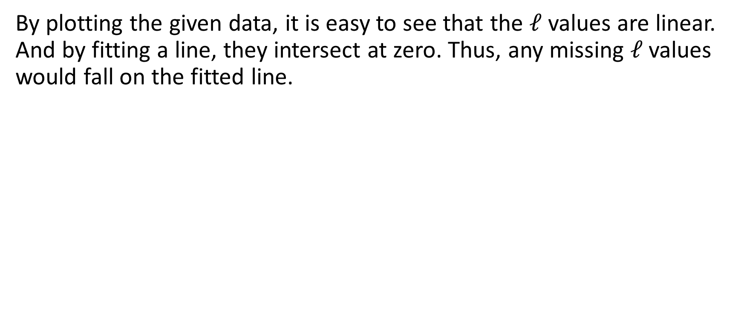
By plotting the given data, it is easy to see that the $ℓ$ values are linear. And by fitting a line, they intersect at zero. Thus, any missing $ℓ$ values would fall on the fitted line.

Slide 52
The next plot shows the given and calculated values, which are used to perform the SEC cross section calculations.

Slide 54
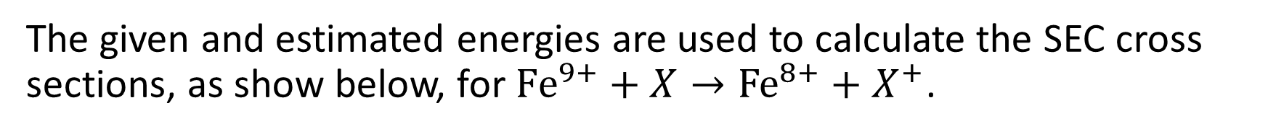
The given and estimated energies are used to calculate the SEC cross sections, as show below, for ${Fe}^{9+}+X→{Fe}^{8+}+X^{+}$.

Slide 55
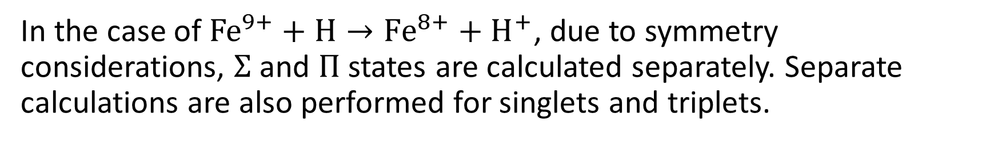
In the case of ${Fe}^{9+}+H→{Fe}^{8+}+H^{+}$, due to symmetry considerations, $Σ$ and $Π$ states are calculated separately. Separate calculations are also performed for singlets and triplets.

Slide 56
The four separate results are summed into n-resolved and total cross sections.

Slide 57

$${Fe}^{9+}+H_{2}→{Fe}^{8+}+H_{2}^{+}$$

Slide 58

$${Fe}^{9+}+He→{Fe}^{8+}+{He}^{+}$$

Slide 59
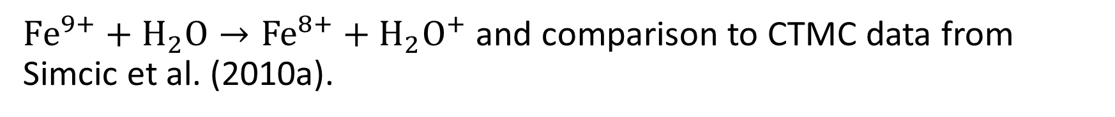
${Fe}^{9+}+H_{2}O→{Fe}^{8+}+H_{2}O^{+}$ and comparison to CTMC data from Simcic et al. (2010a).

Slide 60
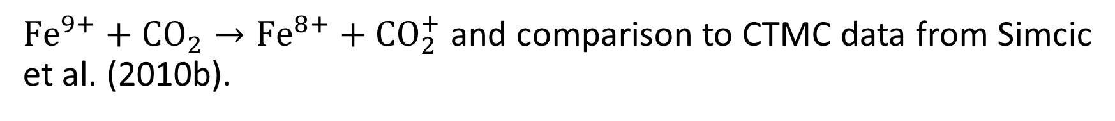
${Fe}^{9+}+{CO}_{2}→{Fe}^{8+}+CO_{2}^{+}$ and comparison to CTMC data from Simcic et al. (2010b).

Slide 61
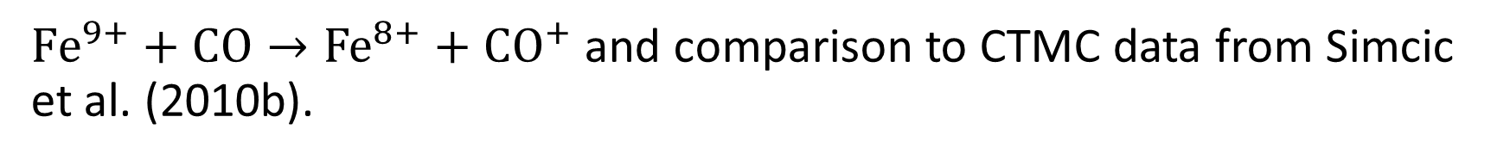
${Fe}^{9+}+CO→{Fe}^{8+}+CO^{+}$ and comparison to CTMC data from Simcic et al. (2010b).

Slide 62

$${Fe}^{9+}+N_{2}→{Fe}^{8+}+N_{2}^{+}$$

Slide 63
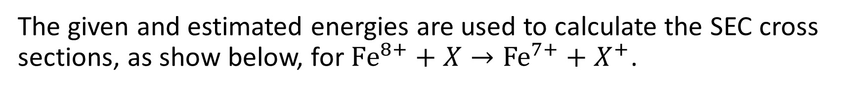
The given and estimated energies are used to calculate the SEC cross sections, as show below, for ${Fe}^{8+}+X→{Fe}^{7+}+X^{+}$.

Slide 64

$${Fe}^{8+}+H_{1−2}→{Fe}^{7+}+H_{1−2}^{+}$$

Slide 65
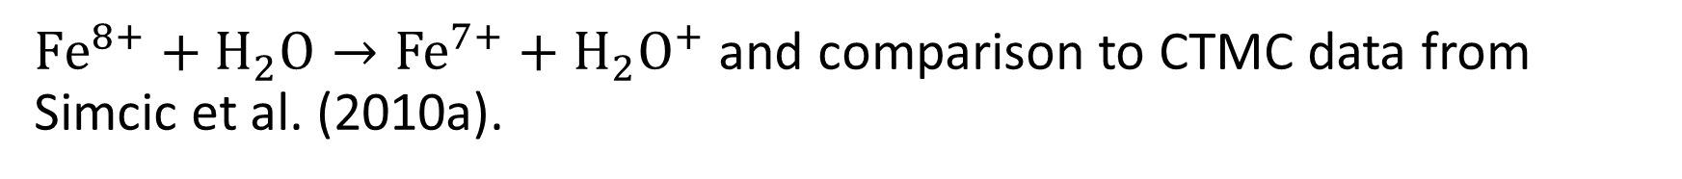
${Fe}^{8+}+H_{2}O→{Fe}^{7+}+H_{2}O^{+}$ and comparison to CTMC data from Simcic et al. (2010a).

Slide 66
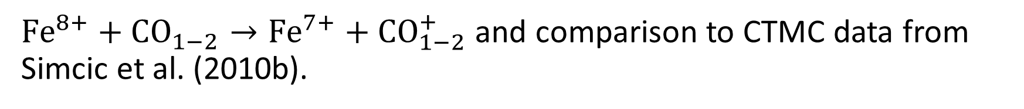
${Fe}^{8+}+{CO}_{1−2}→{Fe}^{7+}+CO_{1−2}^{+}$ and comparison to CTMC data from Simcic et al. (2010b).

Slide 67

$${Fe}^{8+}+N_{2}→{Fe}^{7+}+N_{2}^{+}$$

Slide 68
Summary
It was determined that the results in this study were consistent with the compared data, and thus, the MCLZ method can be reasonably accurate for calculating SEC cross sections.

Slide 69

$${Ne}^{9+}+H→{Ne}^{8+}+H^{+}$$
The MOCC method is used to calculate singlet SEC cross sections for this system. The adiabatic potential and non adiabatic coupling (rotational and radial) data are provided by Peter Liebermann, who generates the data with the multi-reference single and double-configuration interaction (MRDCI) method.

Slide 70
Significant “tweaking” is involved to determine the correct parameters to use for the numerical calculation. For example, for each energy point, it is necessary to determine the number of partial waves that can be used. The more partial waves, the more accurate the result. However, using too many partial waves can cause run-time errors in the software. So tests are perform to determine the number of partial waves. The higher the energy, the more partial waves can be used.
A similar matter exists with determining the maximum value of R, the internuclear distance, over which to integrate. The maximum value of R decreases as initial energy increases.

Slide 71
48 channels of MRDCI singlets are provided for calculation of cross sections. The potentials range from R=2 to R=50, as show below.

Slide 72
A closer look at channels 14—38 reveals the avoided crossings.

Slide 73
Using 38 as the incoming channel, the following singlet cross section data are given at energies of 1, 10, 100, and 1000 eV/u. These data are compared with MCLZ singlet cross sections.

Slide 74
The MOCC and MCLZ cross sections at 1 and 10 eV/u are reasonably close. However, at 100 and 1000 eV/u, they are separated by approximately an order of magnitude.
The reason for this is likely the number of partial waves used for these energy values.

Slide 75
Testing reveals the number of partial waves that can be used for a particular energy value. They are given below. These limitations on the number of partial waves are limited by the software used to calculate them.
Energy eV/u | Max # of partial waves | Actual # of partial waves used
1 | 23 | 23
10 | 32 | 32
100 | 164 | 100
1000 | 360 | 200

Slide 76
Computations are currently being performed with the maximum allowed partial waves. It is expected that the increase in the number of partial waves will lead to an increase in the values of the cross sections, and bring them closer to the MCLZ cross sections.
Triplet cross sections will then be calculated.

Slide 77
n-resolved cross sections between the two method deviate greatly. Only n=5 could be considered to be reasonable close. The dominant channel in the MCLZ method is n=6. But for MOCC, it is 0 at these energy points.

Slide 78
Summary
The MOCC method is computationally intensive. Cross sections for energy points, particularly over 10 eV/u, can take over 12 hours to complete. For energy points of 1000 eV/u, cross section calculations can require ~48 hours.
The MOCC method appears to be consistent with total cross sections calculated by other methods. But n-resolved cross sections deviate from those of MCLZ.
In my opinion, substantially more work is involved to obtain far fewer data than with a method such as MCLZ. Thus, the MOCC method might be better suited for supercomputers.

Slide 79
Stüeckelberg
This is a software package, written in C, to execute the MCLZ method.
It is designed to be versatile, where critical parameters are specified by command-line options. It makes extensive use of dynamic memory allocation, so the limits to the amount of data which can be used are determined by the machine and its OS.
Stüeckelberg was used to perform all the MCLZ calculations in these studies. It was also used by P Mullen and R Cumbee in their research.

